Slide 1

Slide 1
ANALYSIS OF AMERICAN EXPRESS
Aman Jaglan

Slide 2

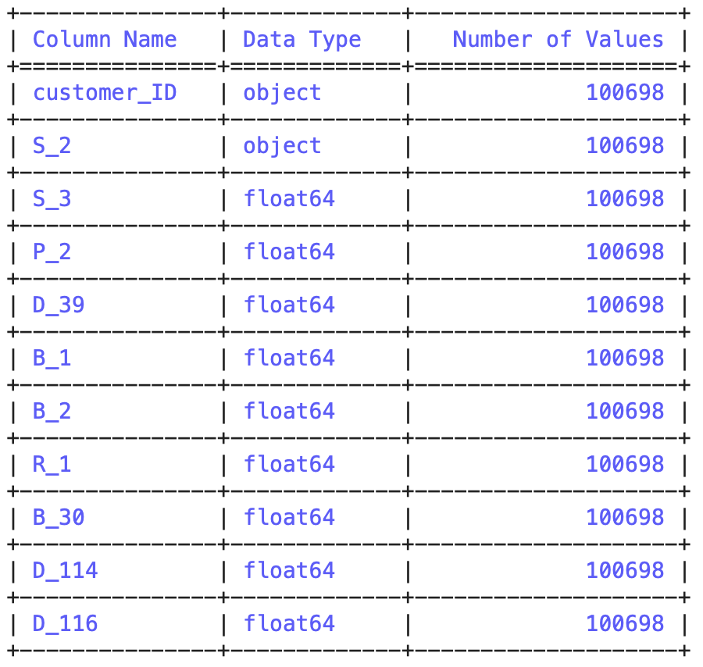
Slide 10
DATA DESCRIPTION
S_3 : Spend Behavior
P_2 : Payment Behavior
D_39 : Delinquency Behavior B_1 : Balance type 1 (Checking account)
B_2: Balance Type 2 (Savings account)
R_1 : Risk Factor B_30: Different types of balances.
2

Slide 3
Slide 9
Goals To Achieve
Identify the types of account and balance behavior of customers that lead to an increase in the risk factor.
To gain knowledge of expenditure for different accounts and determine whether it is safe spending or not.
Risk
Payment Behavior
Delinquency
Balance Behavior
Spend Behavior
Needs to identify the underlying patterns of payment associated with different balance types.
To understand the delinquency patterns across different account types and assess their impact on financial risk.
3

Slide 4
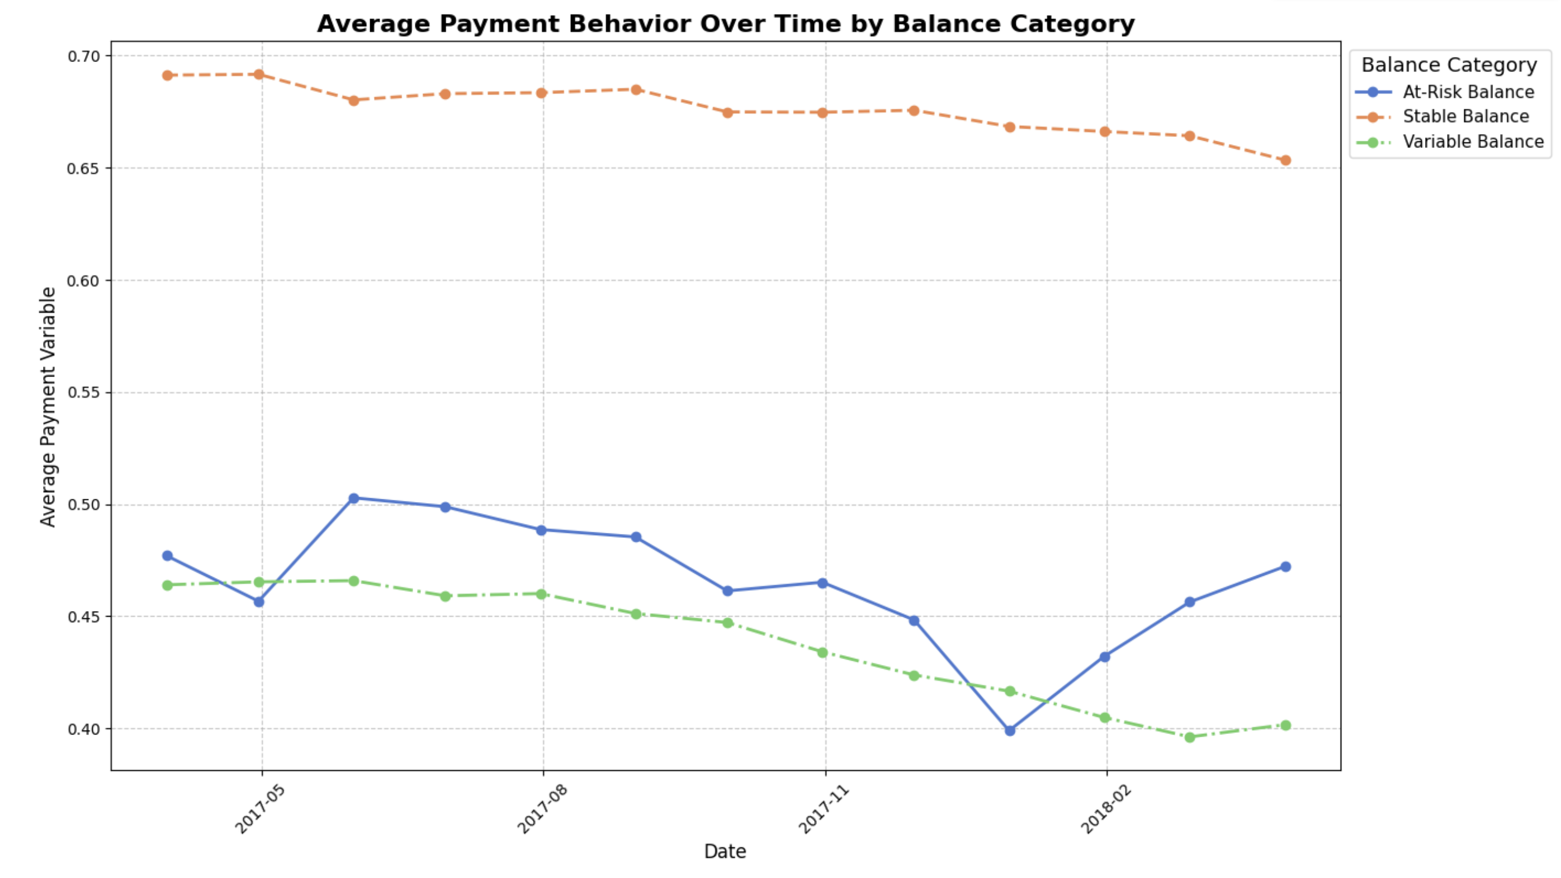
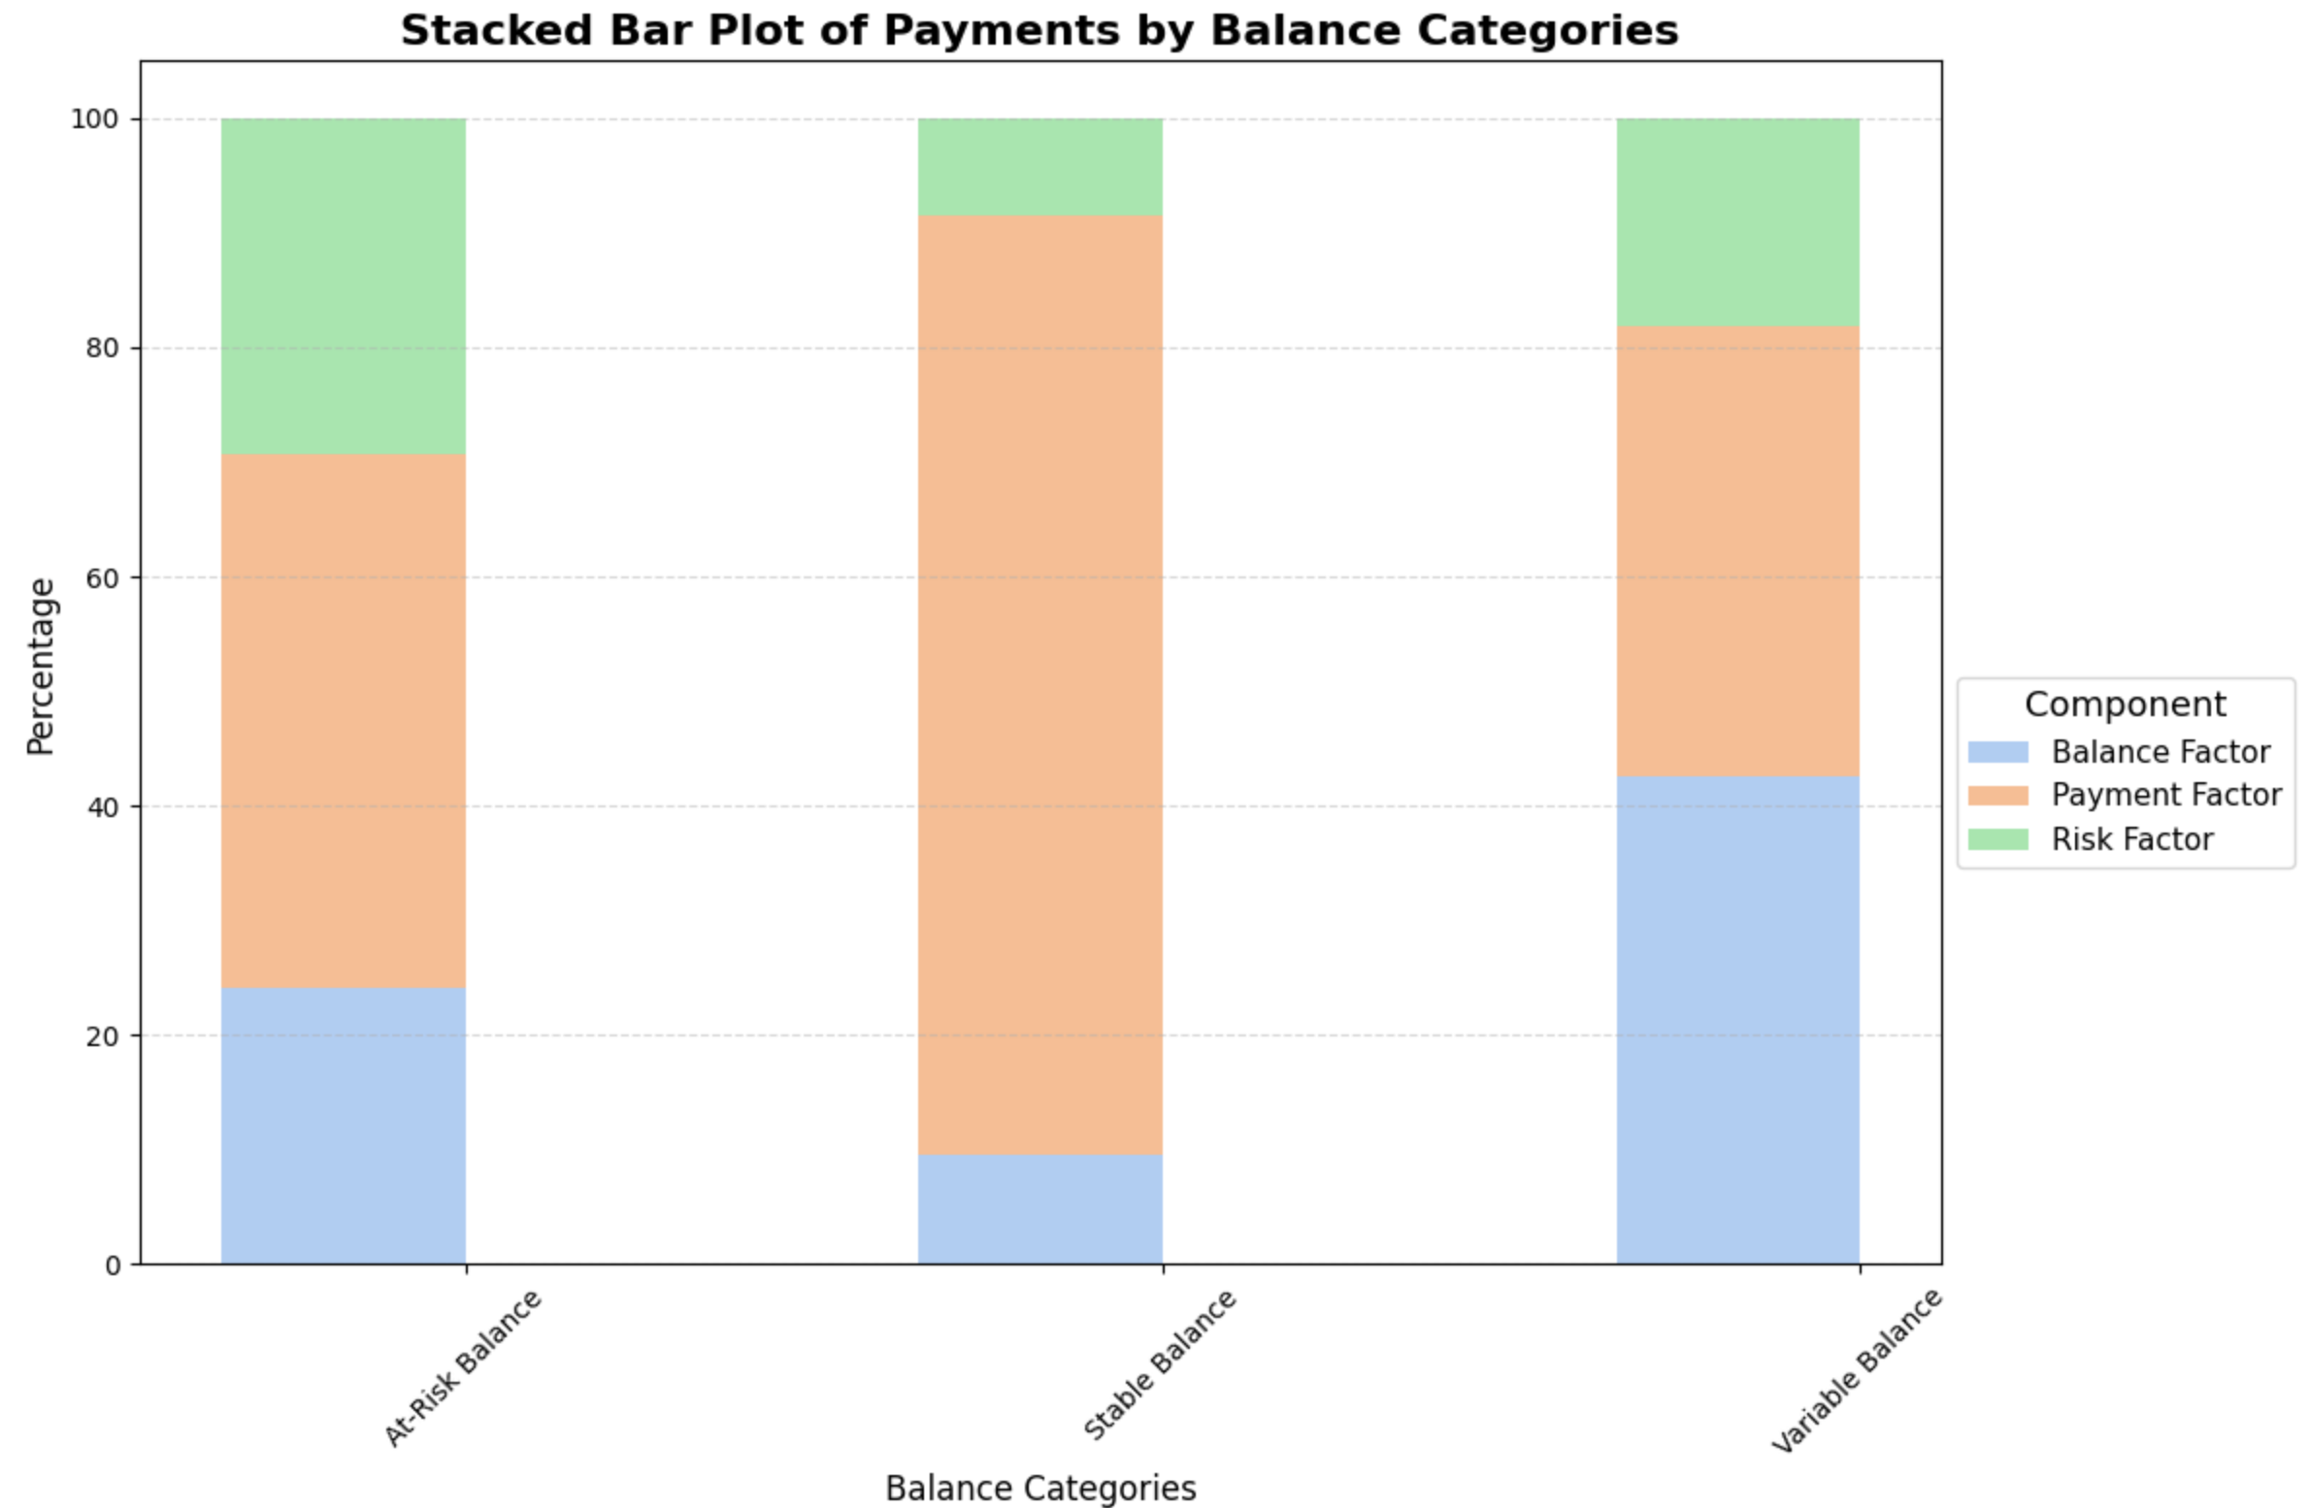
Slide 2
Payments variable analysis
B1- Checking account
B2-Savings account
P2- Payment factor
4

Slide 5
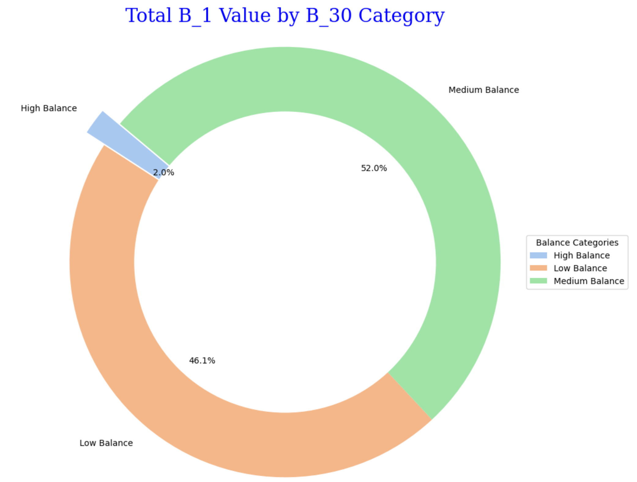
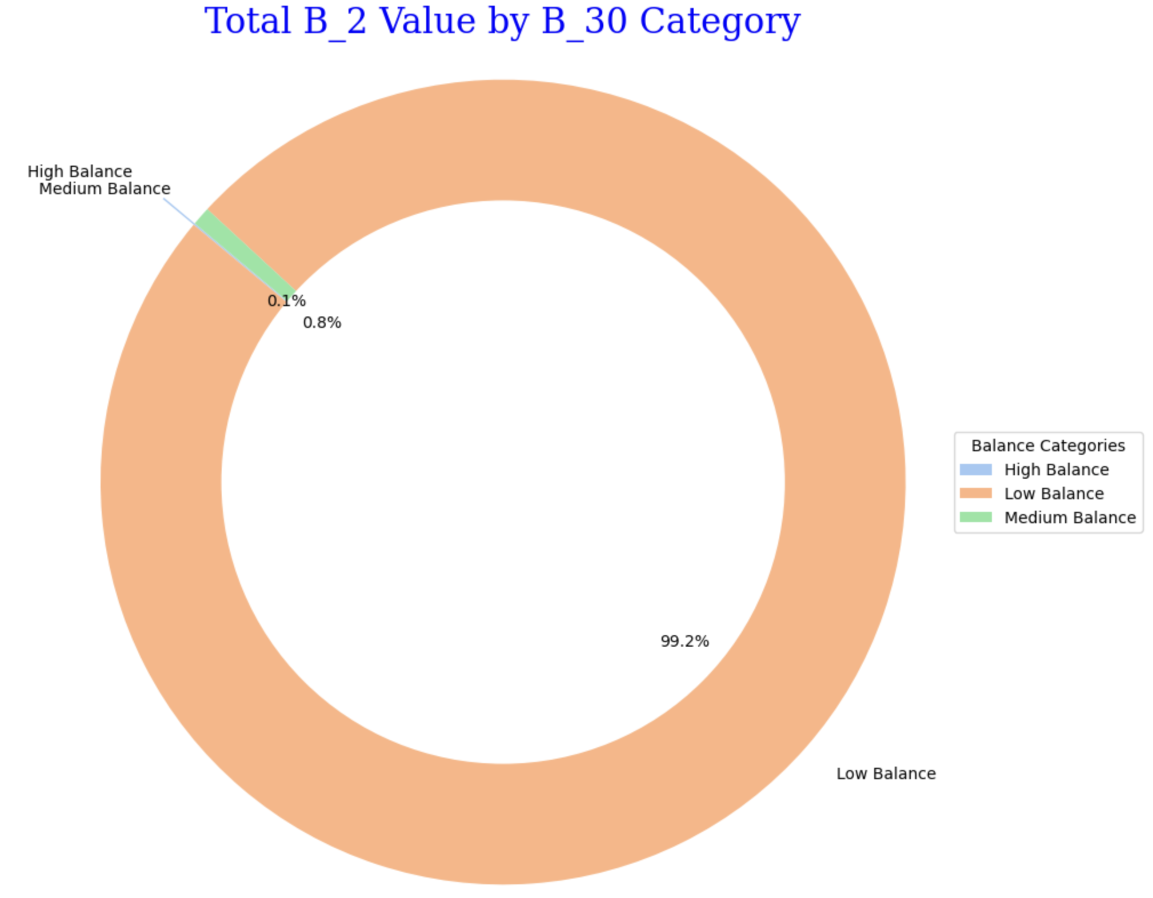
Slide 3
Distribution of Accounts balance
5

Slide 6
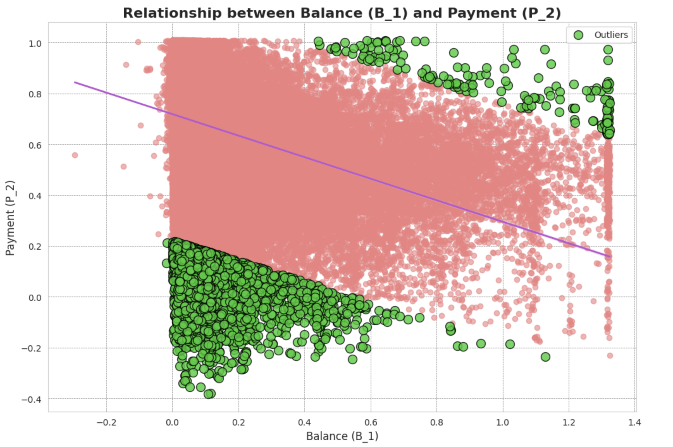
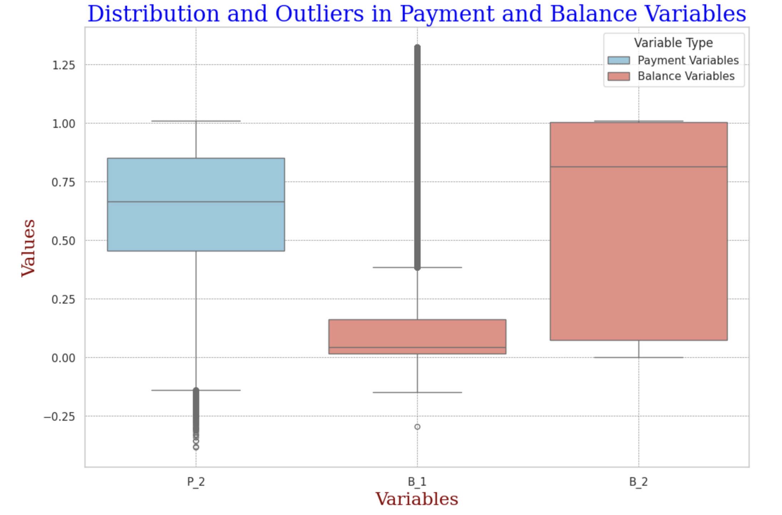
Slide 3
Relationship of Payment and balance
6

Slide 7
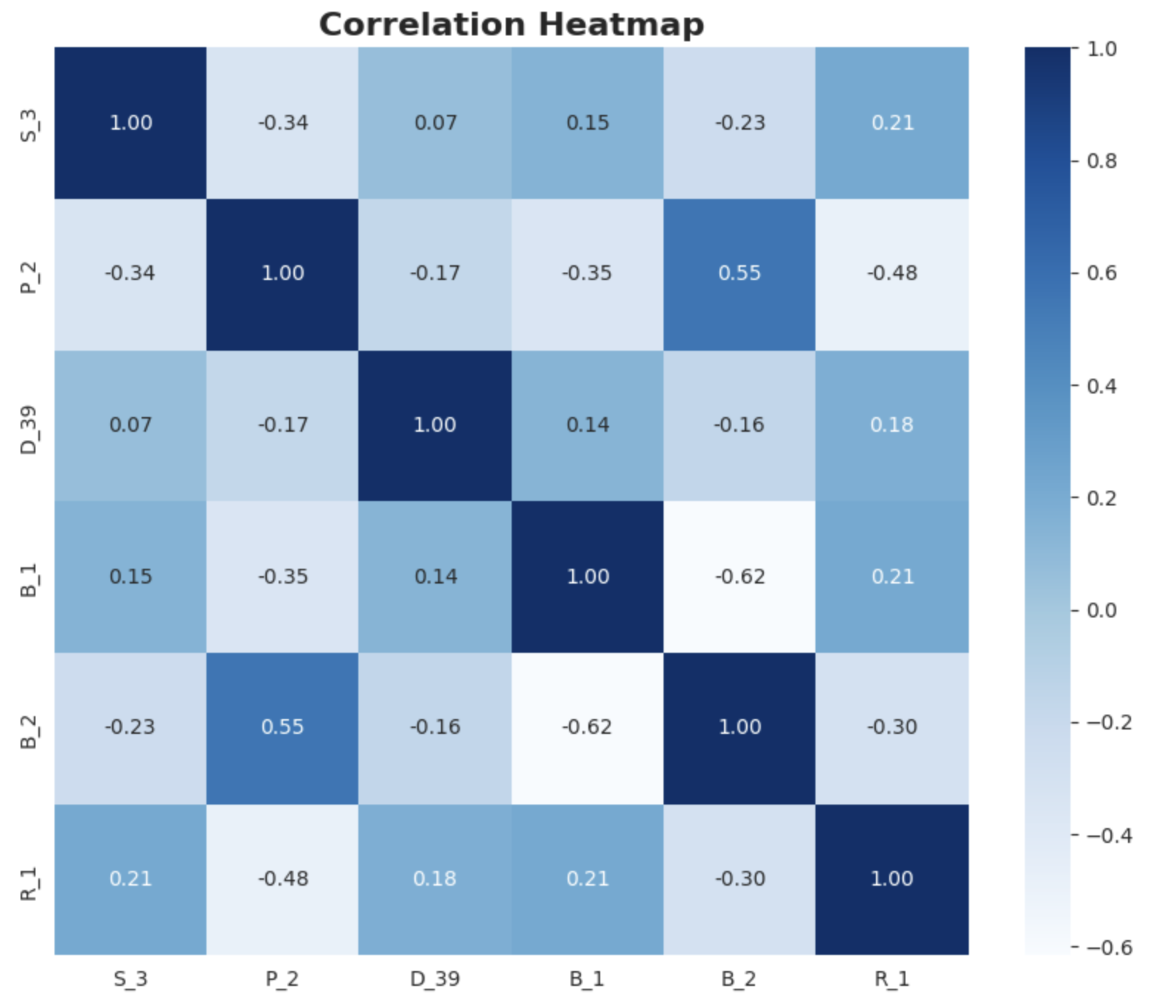
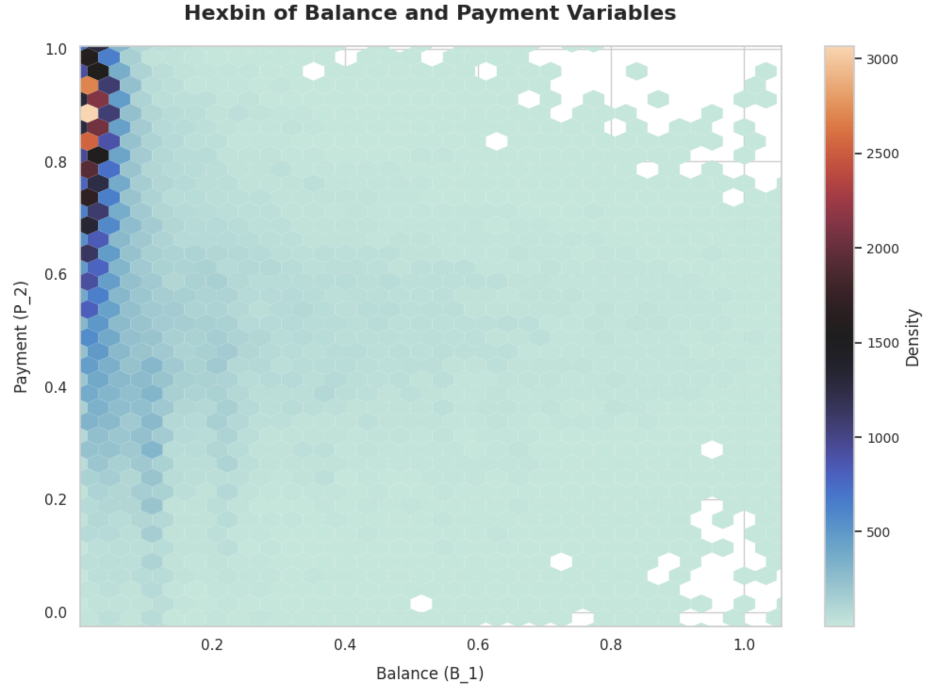
Slide 4
Correlations
Highest and lowest Correlation
B2-P2 = 0.55
B1-B2 = -0.62
Max density
0.6 to 1.0
7

Slide 8
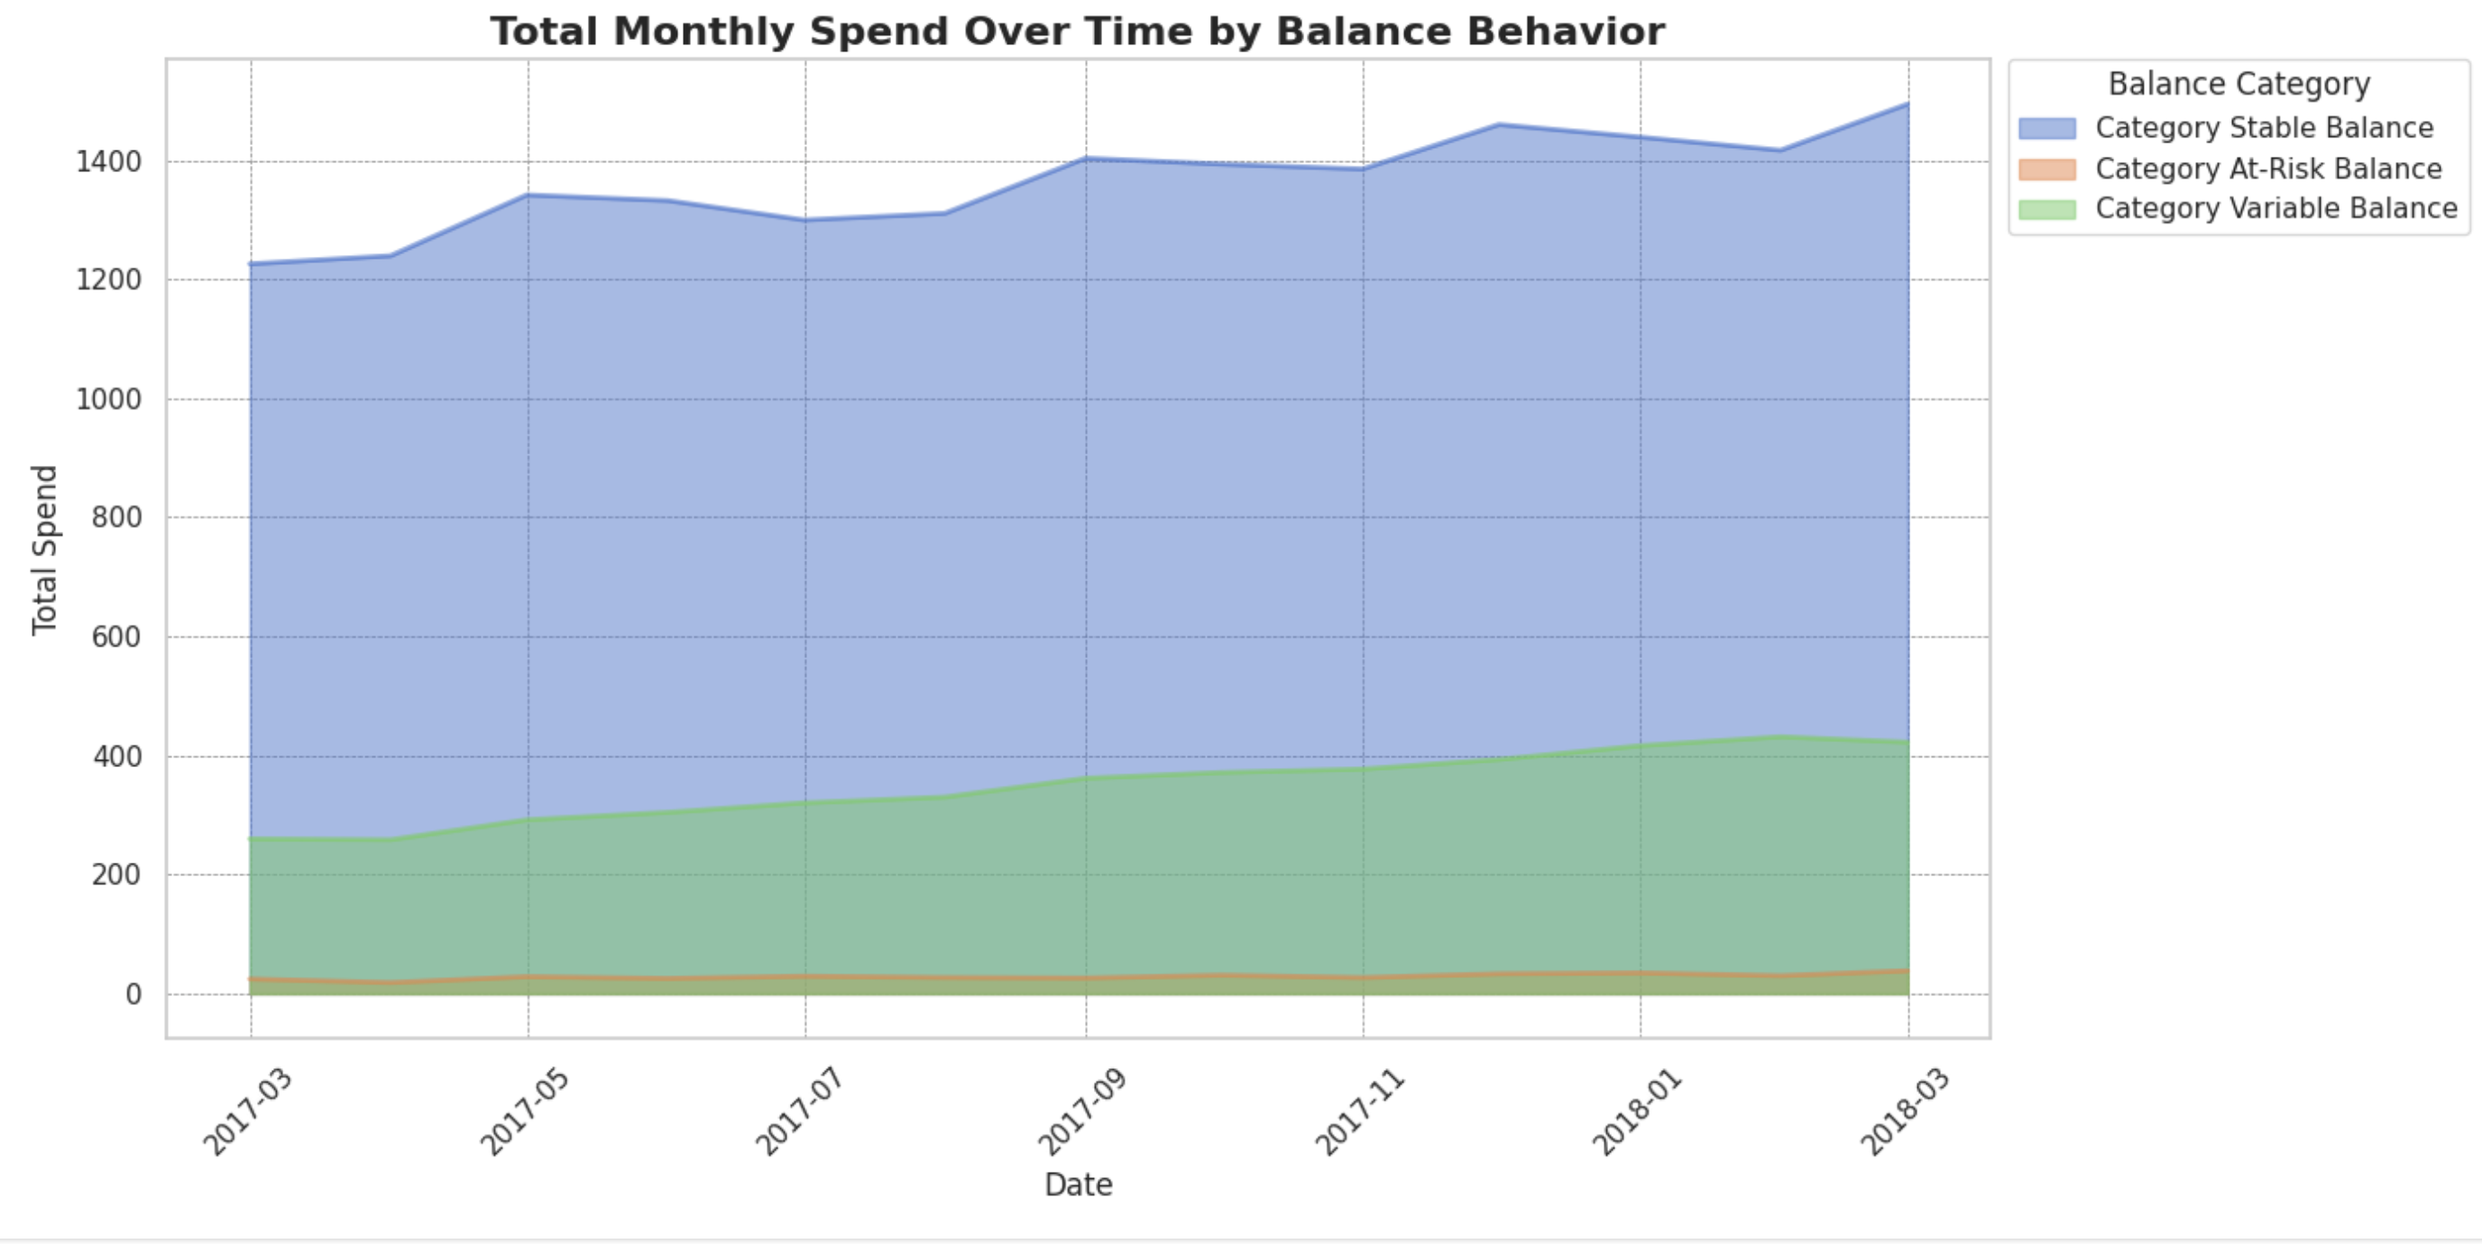
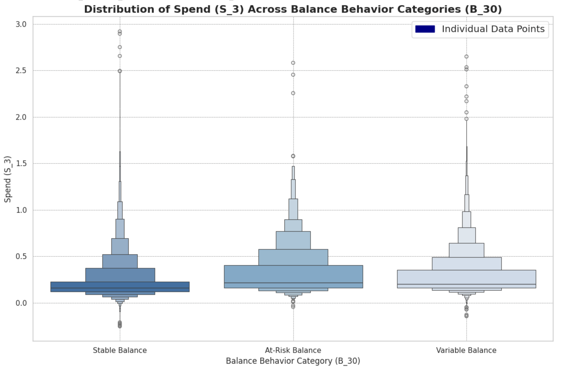
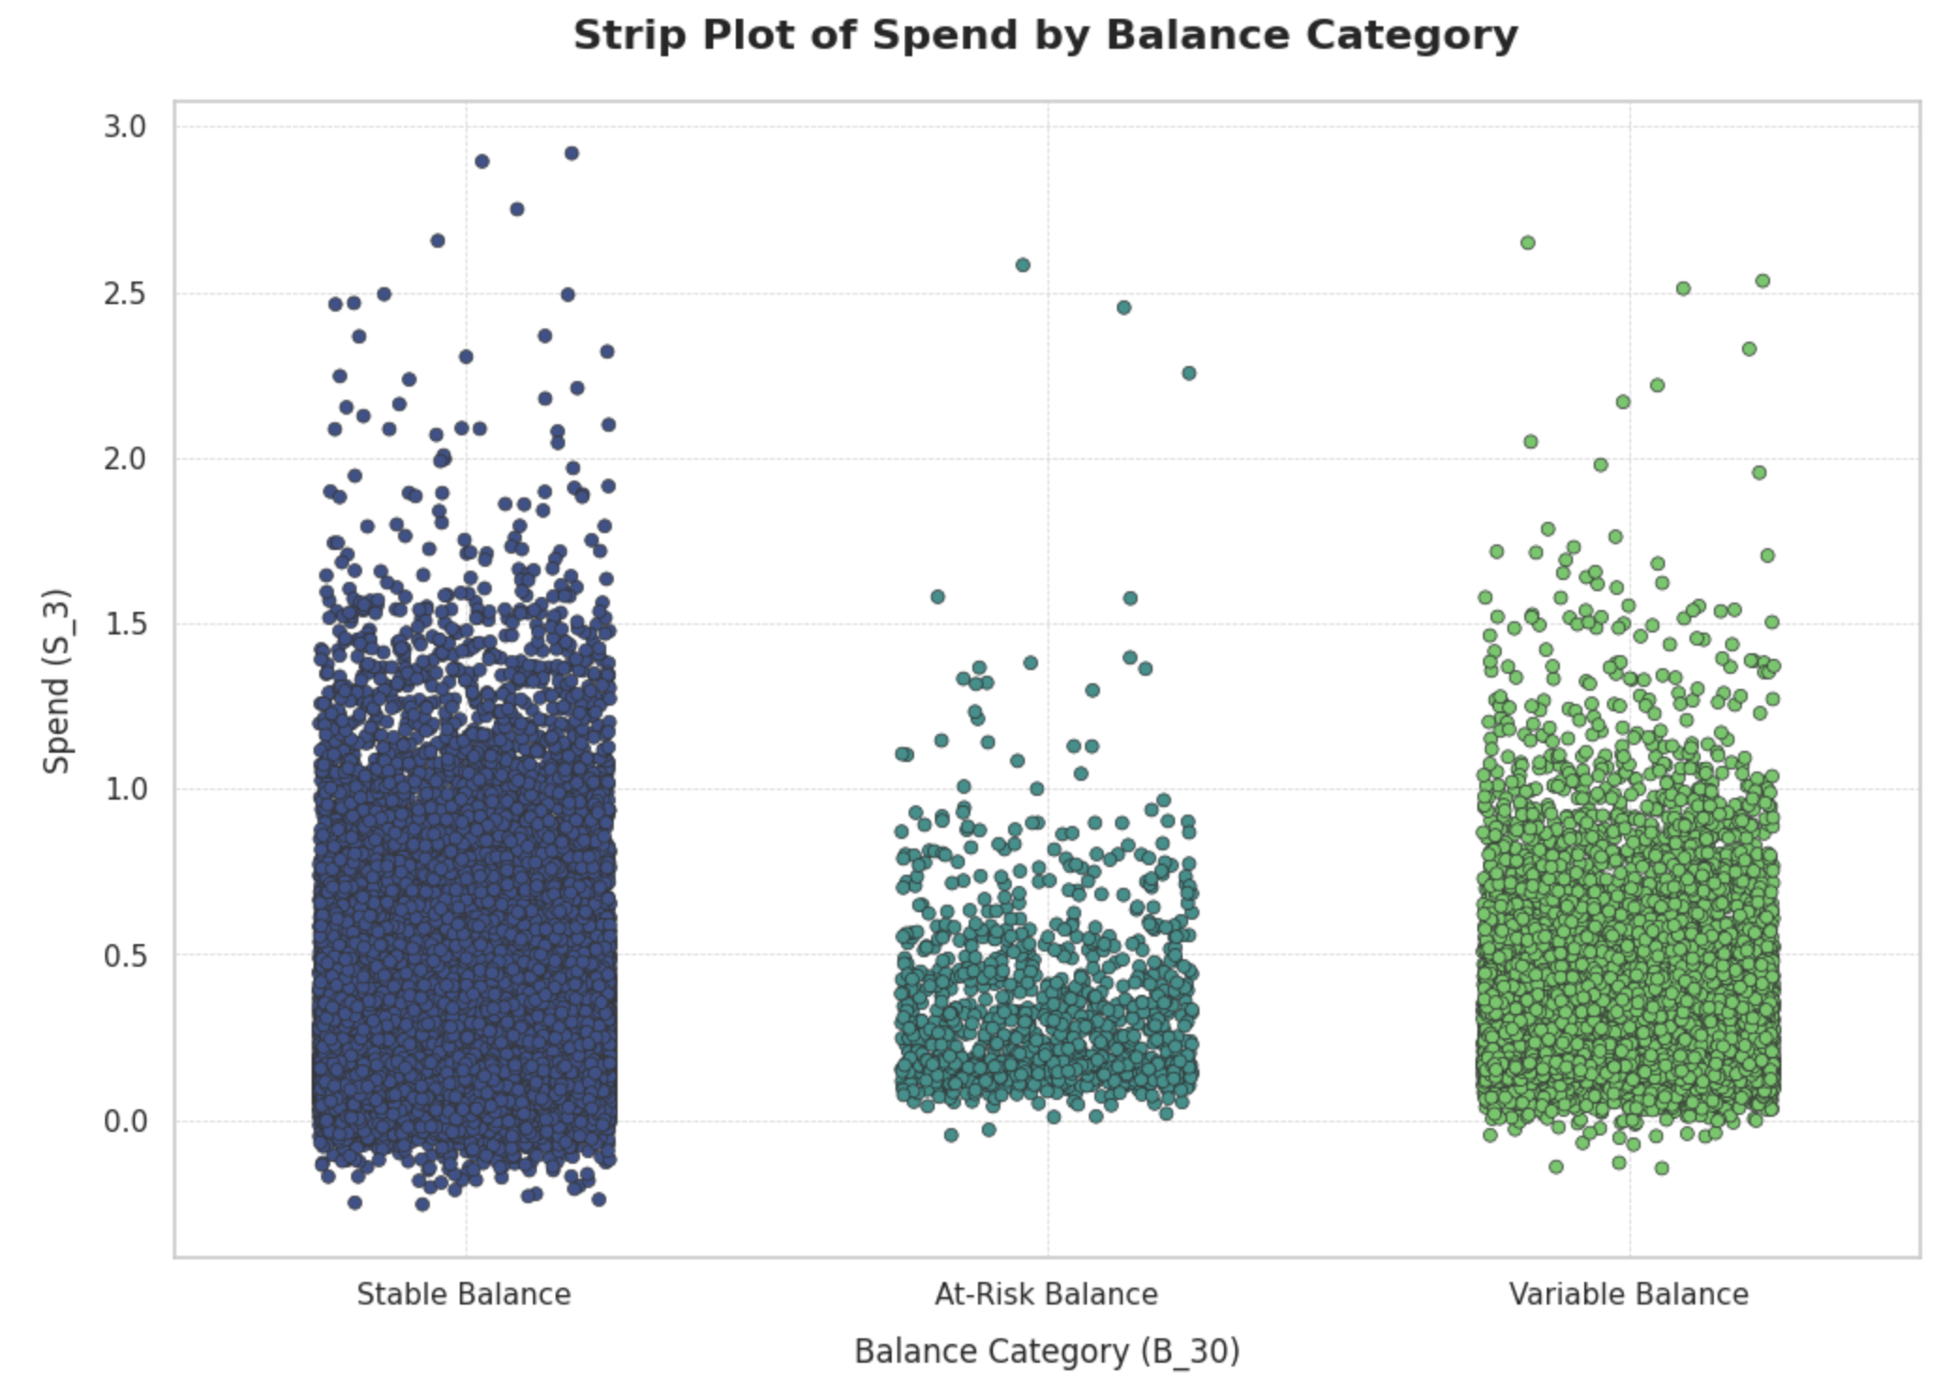
Slide 6
Spend Analysis
8

Slide 9


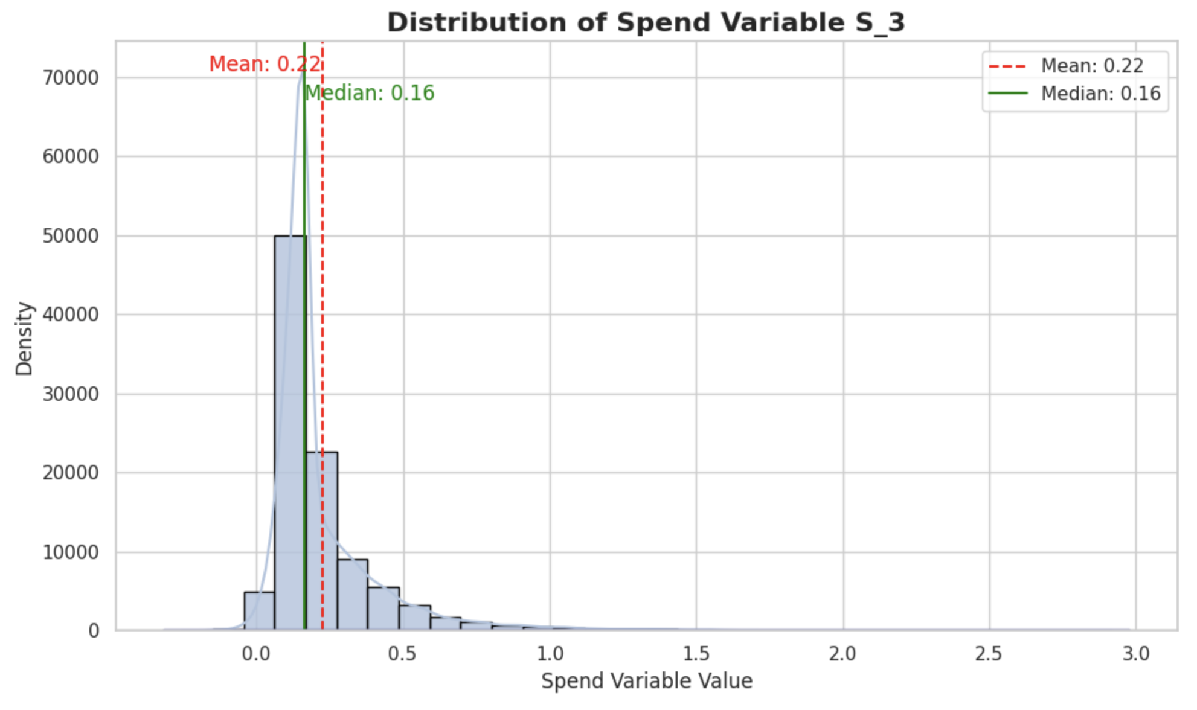
Slide 7
0.22
0.16
Spend Behavior
Right-Skewed Distribution: The data for spend variable S_3 is right-skewed, indicating lower spend values with fewer high spend outliers.
Mean vs. Median: With a mean of 0.22 and a median of 0.16, the mean is inflated by high spend outliers, while the median reflects the central tendency of the majority.
Central Tendency Insight: The median is a better indicator of typical spend behavior due to the right skew of the data, resisting the distortion from outliers.
50k

Slide 10
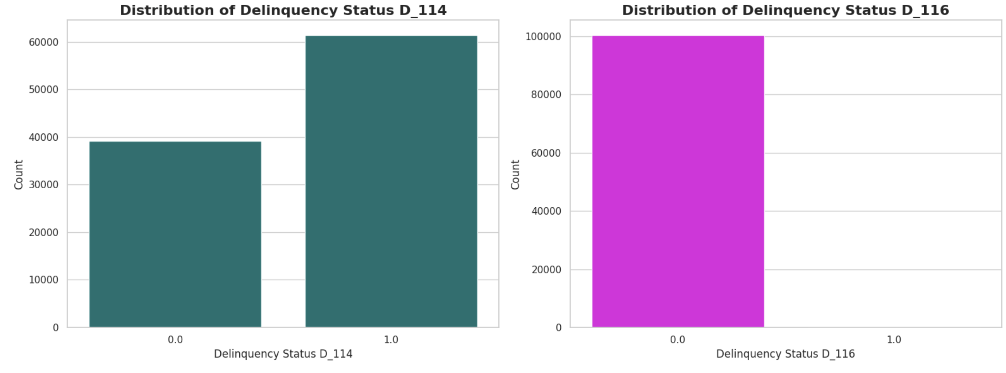
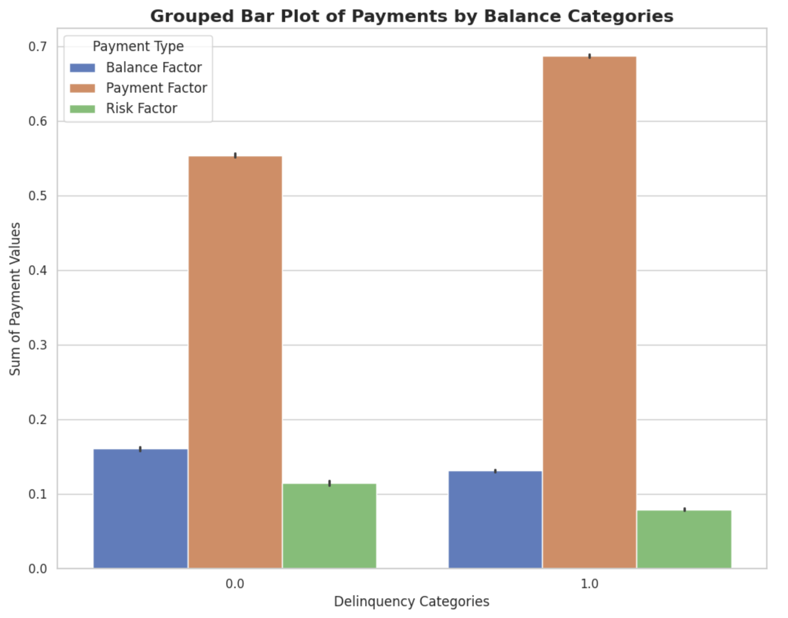
Slide 8
Delinquency Analysis
Balance Factor
Payment factor
Risk factor
10

Slide 11
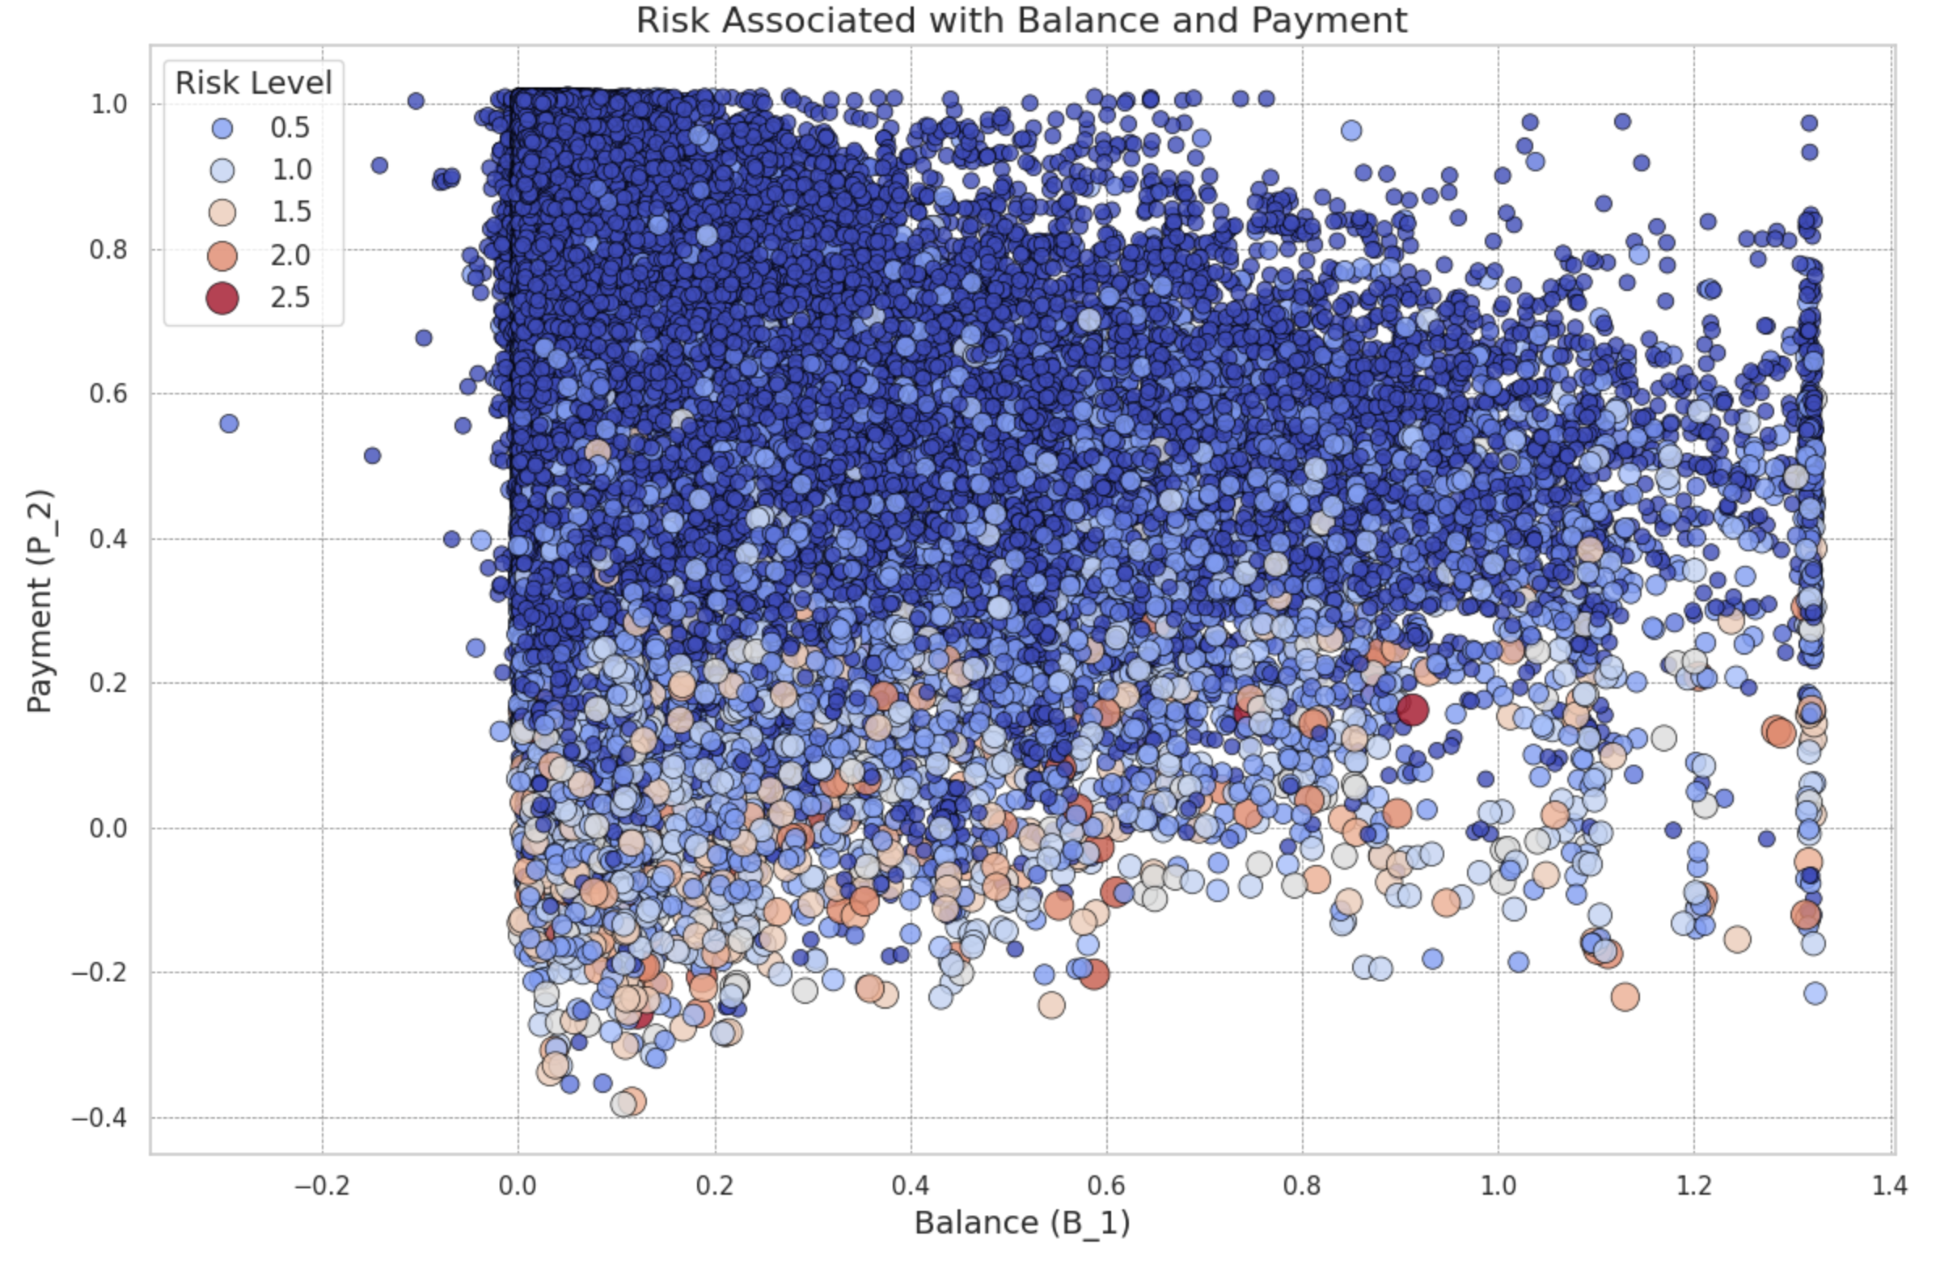
Slide 10
Risk Factor Analysis
Central Clustering: Most balances and payments cluster around moderate values with fewer extremes.
Risk Indicators: Larger, darker points signal higher risk, predominantly at higher balances.
Balance-Risk Link: Higher balances correlate with varied risk levels, suggested by diverse point colors and sizes.
Dashapp Link
11

Slide 12

Slide 11
THANK YOU

